Slide 1
BU Academic Navigator Platform
Group 1 (BUAN) Natasya Liew: Team Leader Natthaphon Foithong: Design and Implementation Lead Ananya Singh: Security Lead Battal Cevik: QA Lead Poom Chantarapornrat: Requirement Lead Yu Jun Liu: Configuration Lead

Slide 2
Iteration 3 Key Updates
Added the `Download chat` functionality in the frontend
Cleaned the code folders and files
Linted, reformat, and annotate the codes
Revised the documents for final release
Integrated the application to AWS EC2 Instance
Fixed more bugs related to the past features and functionalities
Added security feature to the SB backend service
Requirement Checks
Most testing done: unittest, functional, regression tests

Slide 3
About BUAN (BU Academic Navigator)
A chatbot-driven web application to assist students with academic advising.
Uses GPT-4o mini via Langchain API for personalized recommendations.
Frontend: React, Backend: Spring Boot & Python AI Service, Database: PostgreSQL.
AI-Driven: ChatGPT-4o mini via LangChain Chatbot
Customized Course recommendations builder based on student profiles.

Slide 4
Design Goals
Seamless chatbot interaction via real-time communication.
Modular architecture for easy maintenance and scalability.
Performance optimization with client-side and server-side caching.
Secure authentication using JWT tokens and authentication.

Slide 5
Software Architecture
Frontend: React/Vite
Backend: Spring Boot for authentication and chat handling
AI Layer: Python-based script using LangChain tooling for intelligent chatbot responses (supported by ChatGPT-4o mini)
Database: PostgreSQL for chat history and user data
CI/CD: Docker, GitHub Actions, AWS EC2 for deployment

Slide 6
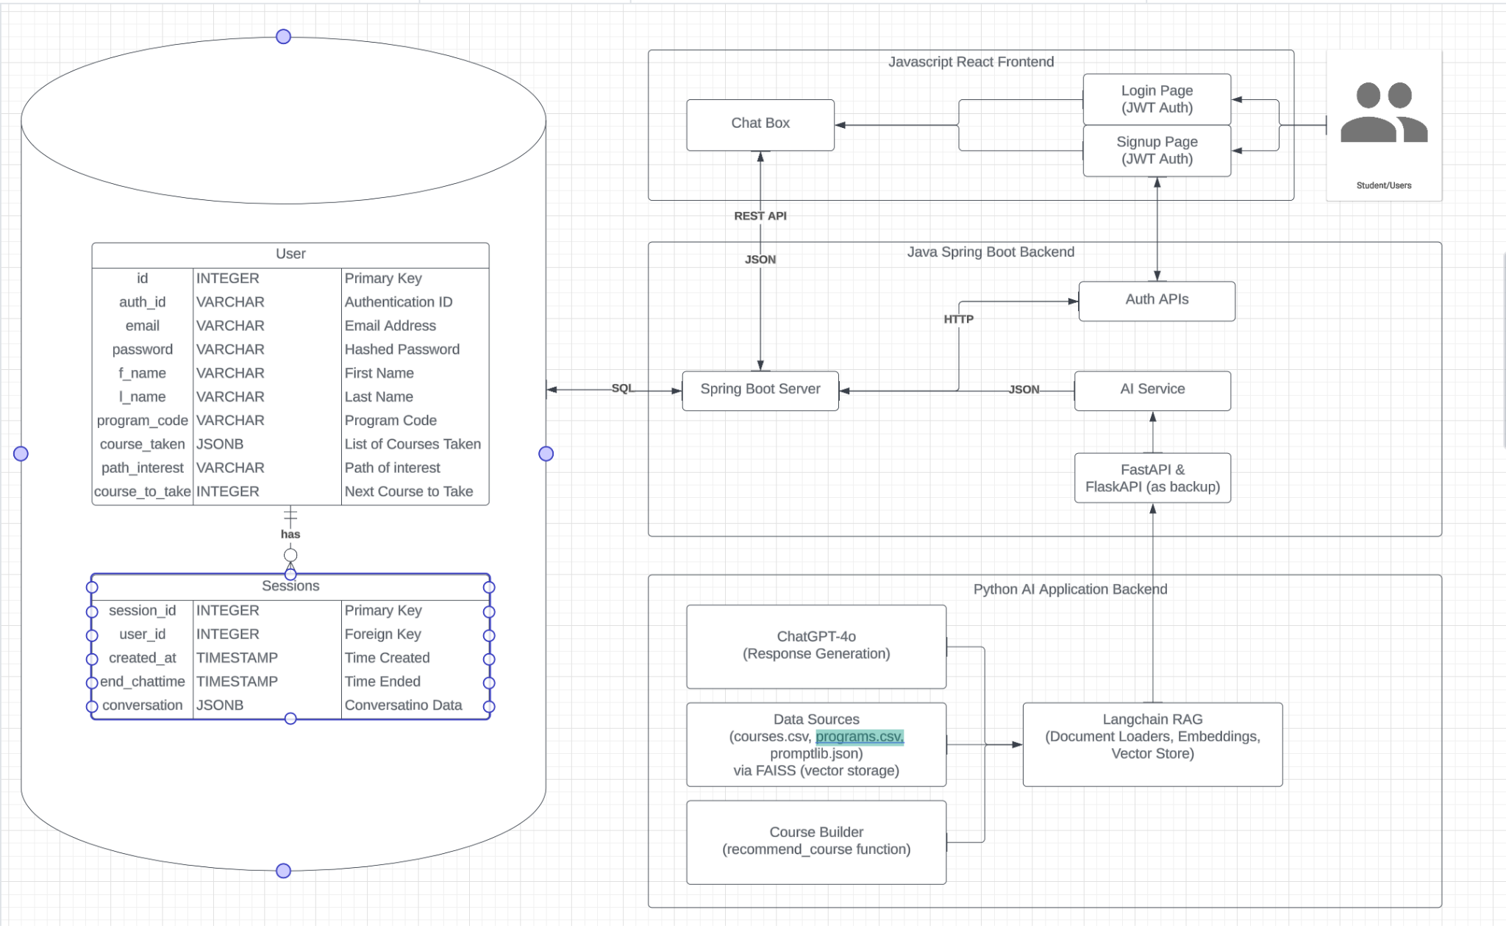
Architecture Diagram

Slide 7
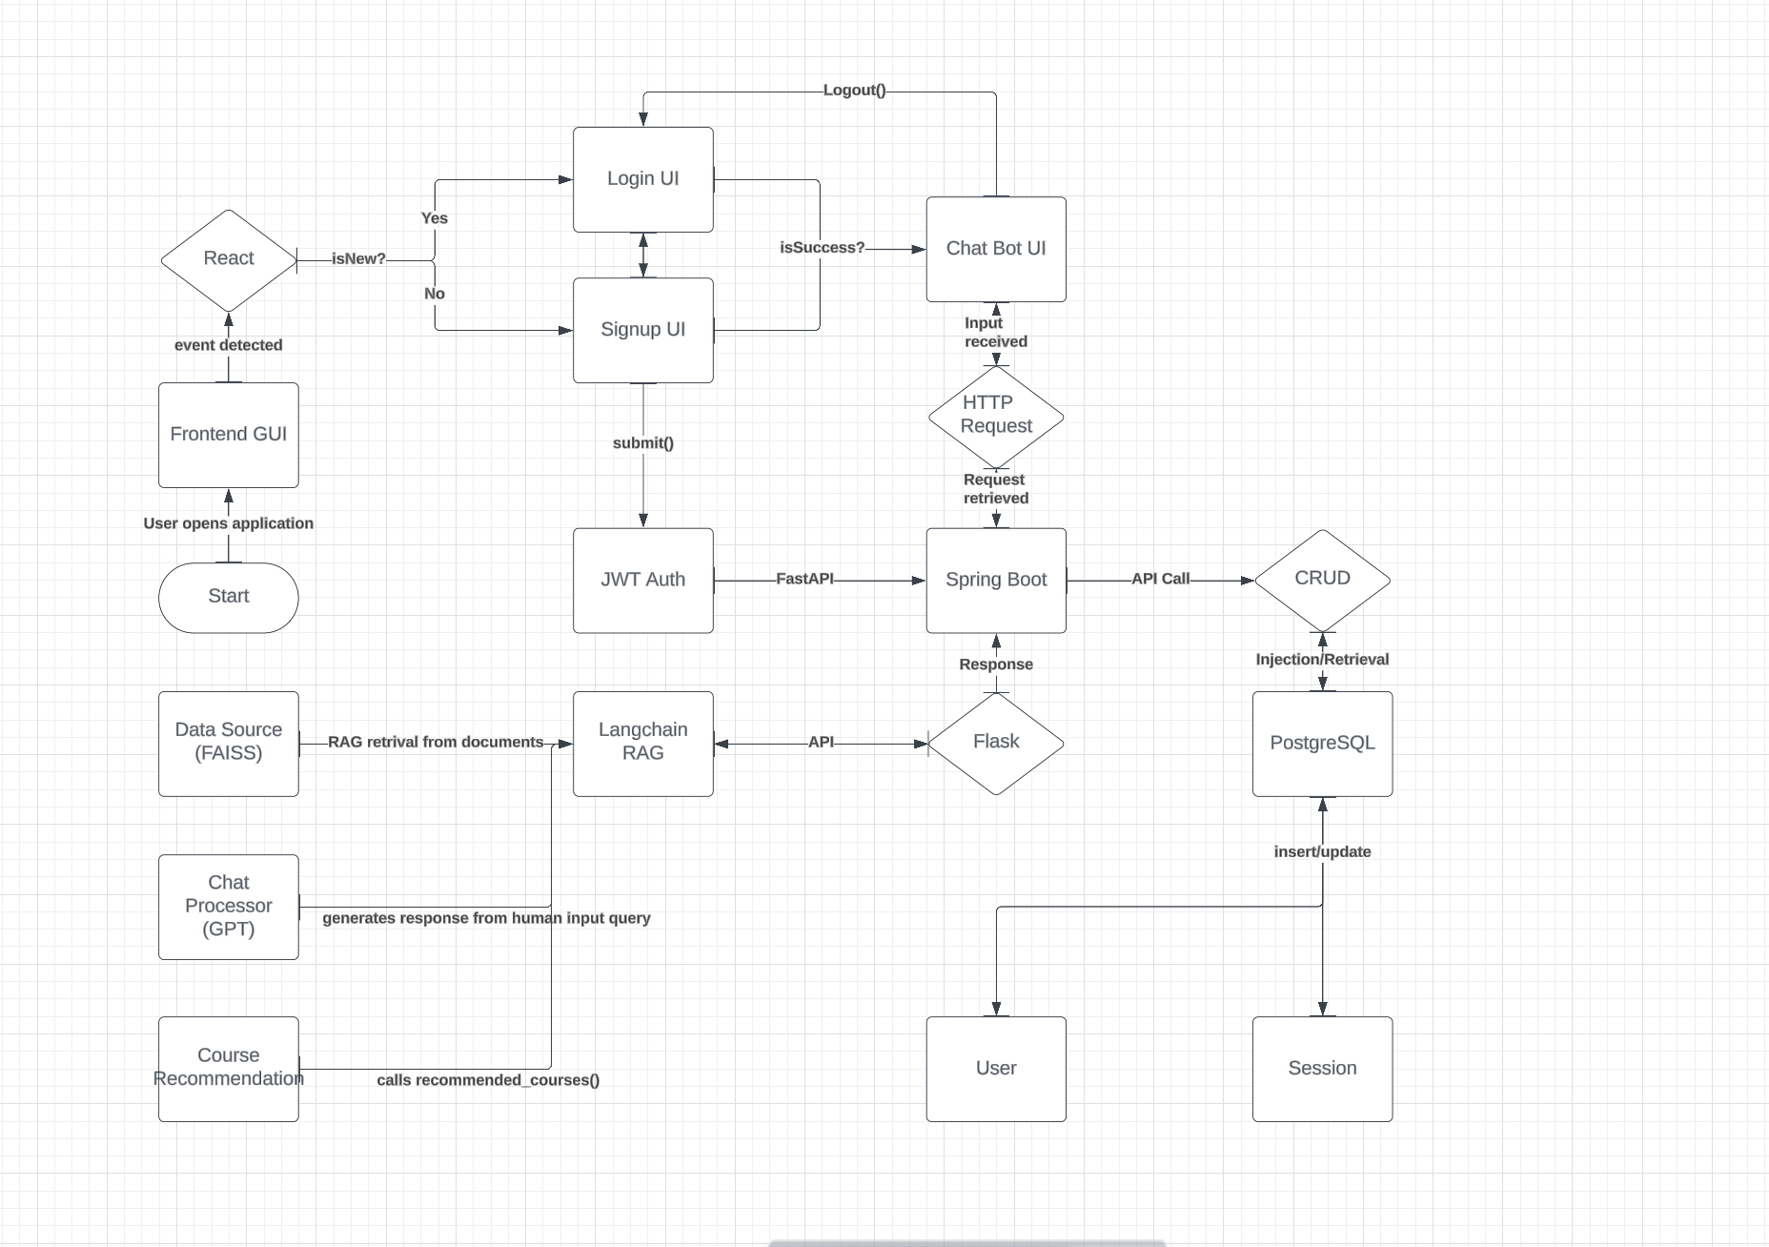
Process Flow Diagram

Slide 8
Frameworks and Libraries
Frontend: React.js, Vite, Axios, Material UI
Backend: Java (Spring Boot), Maven, JWT Tokens/Auth
AI Layer: Langchain, FastAPI, FlaskAPI, Pandas, ChatGPT-4o mini, FAISS (for vector storage)
Automation Testing: Selenium, Cucumber, Jest, TestNG, Maven, Rest Assured API

Slide 9
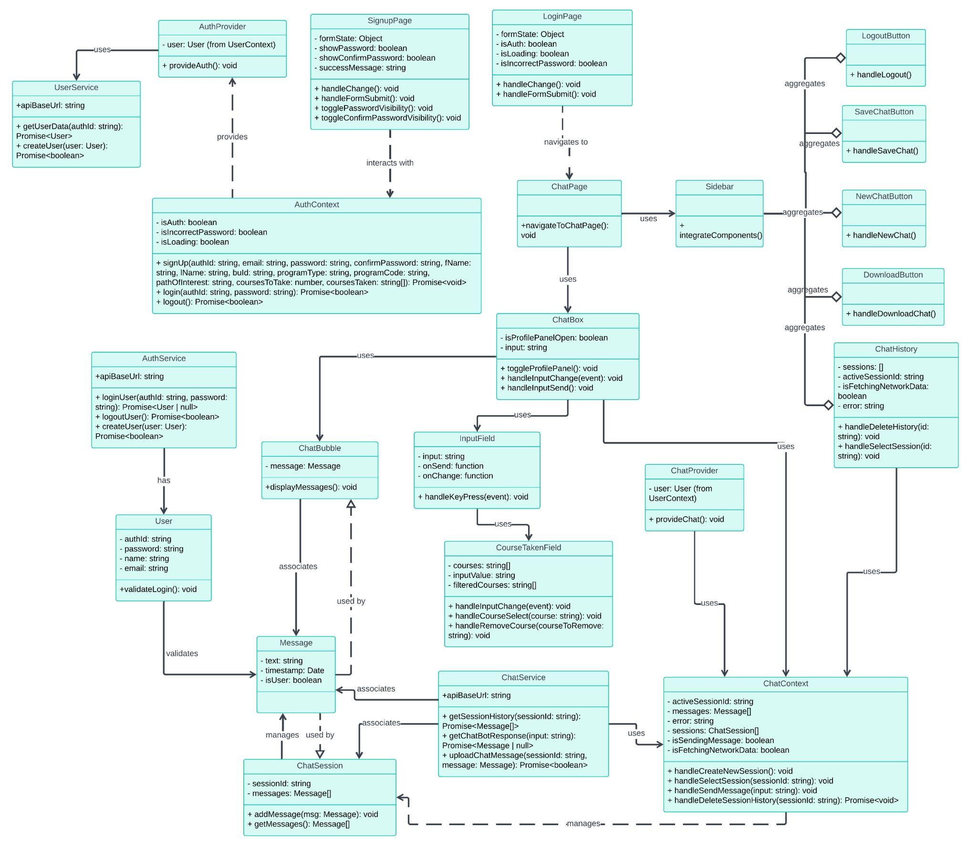
Class Diagram
Notes:
To update

Slide 10
UI Design Overview
Layout: Two-column, two-row structure
Left Column: Side panel for actions (New chat, end chat, email, share, print, logout)
Right Column: Chat interface for conversation
Key UI Components
Chat Interface:
Chat Window: Main area for conversation
Message Bubbles: Distinct bubbles for user (right) and bot (left) messages
Input Field: Text box, send button, optional Grammarly check
Action Buttons:
Logout : Logout and close session
Download History: Prepare a pdf formatted document with the log of the chat history
Save Chat: Stores current chat to the database
New Chat: Creates a new chat session and store current chat session as a chat history.

Slide 11
UI Design Colors and Typography
Color Palette:
#E54500 (Orange-red)
#675DFF (Blue)
#FFD0BC (Light orange)
#FFFFFF (White)
Typography: Outfit, San-serif

Slide 12
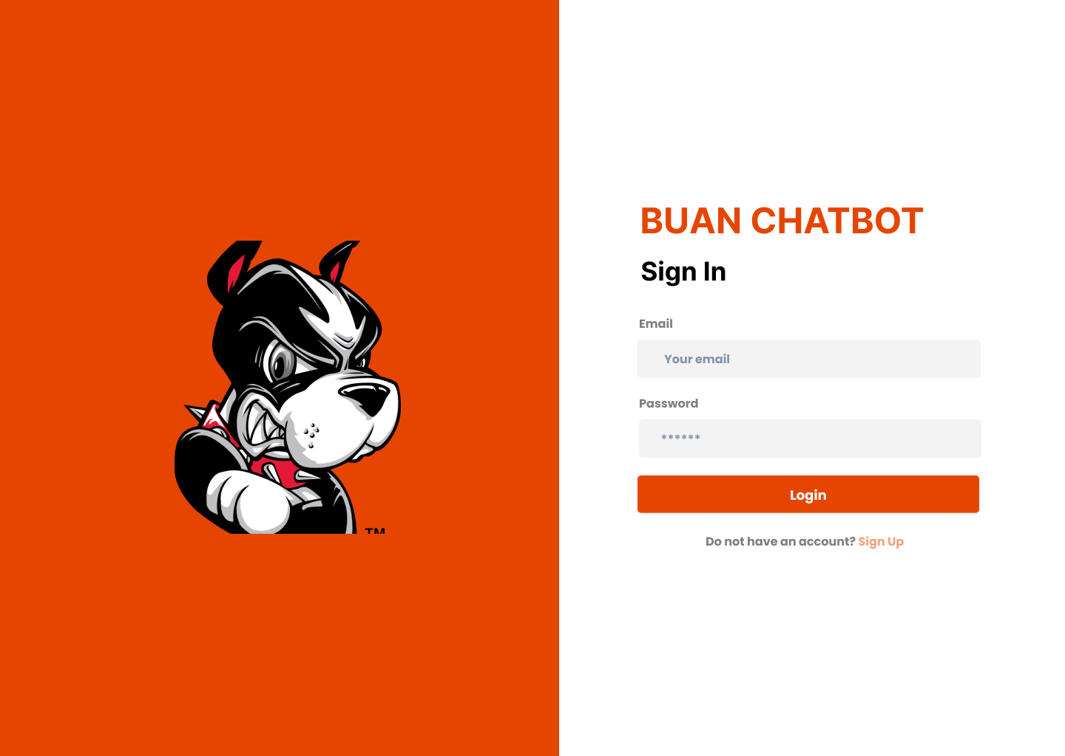
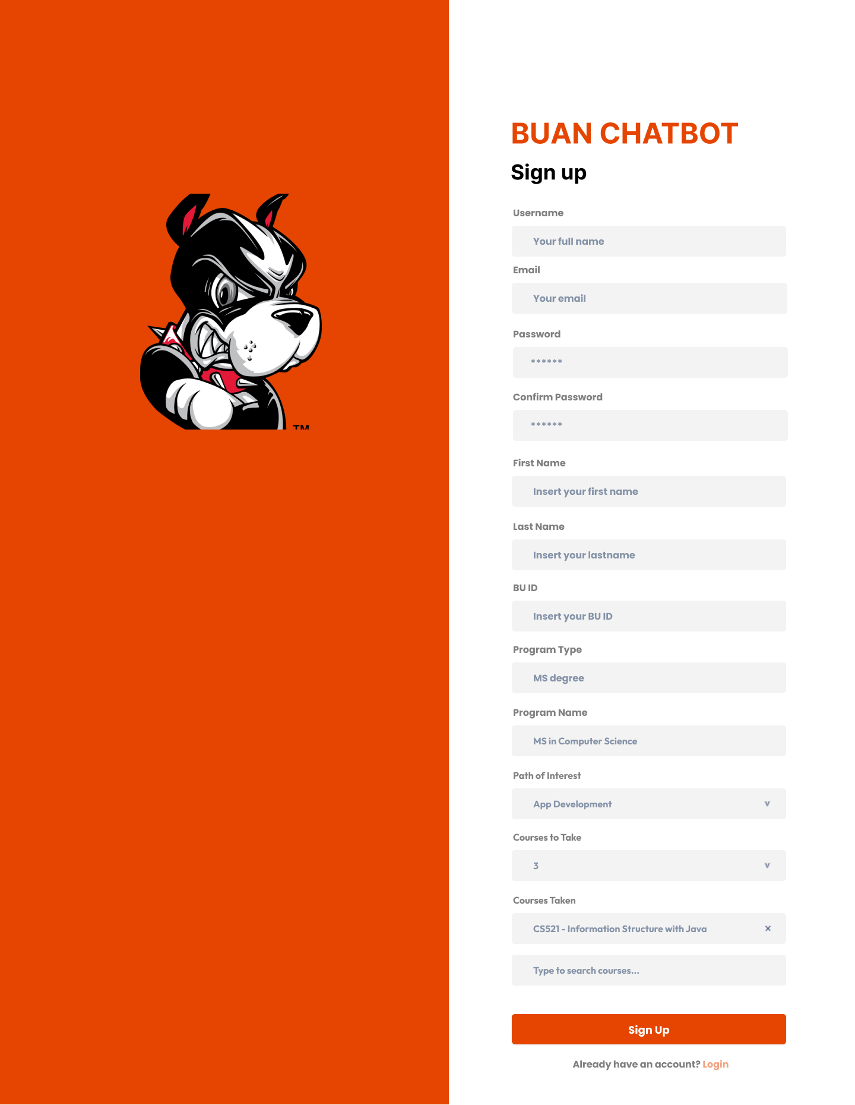
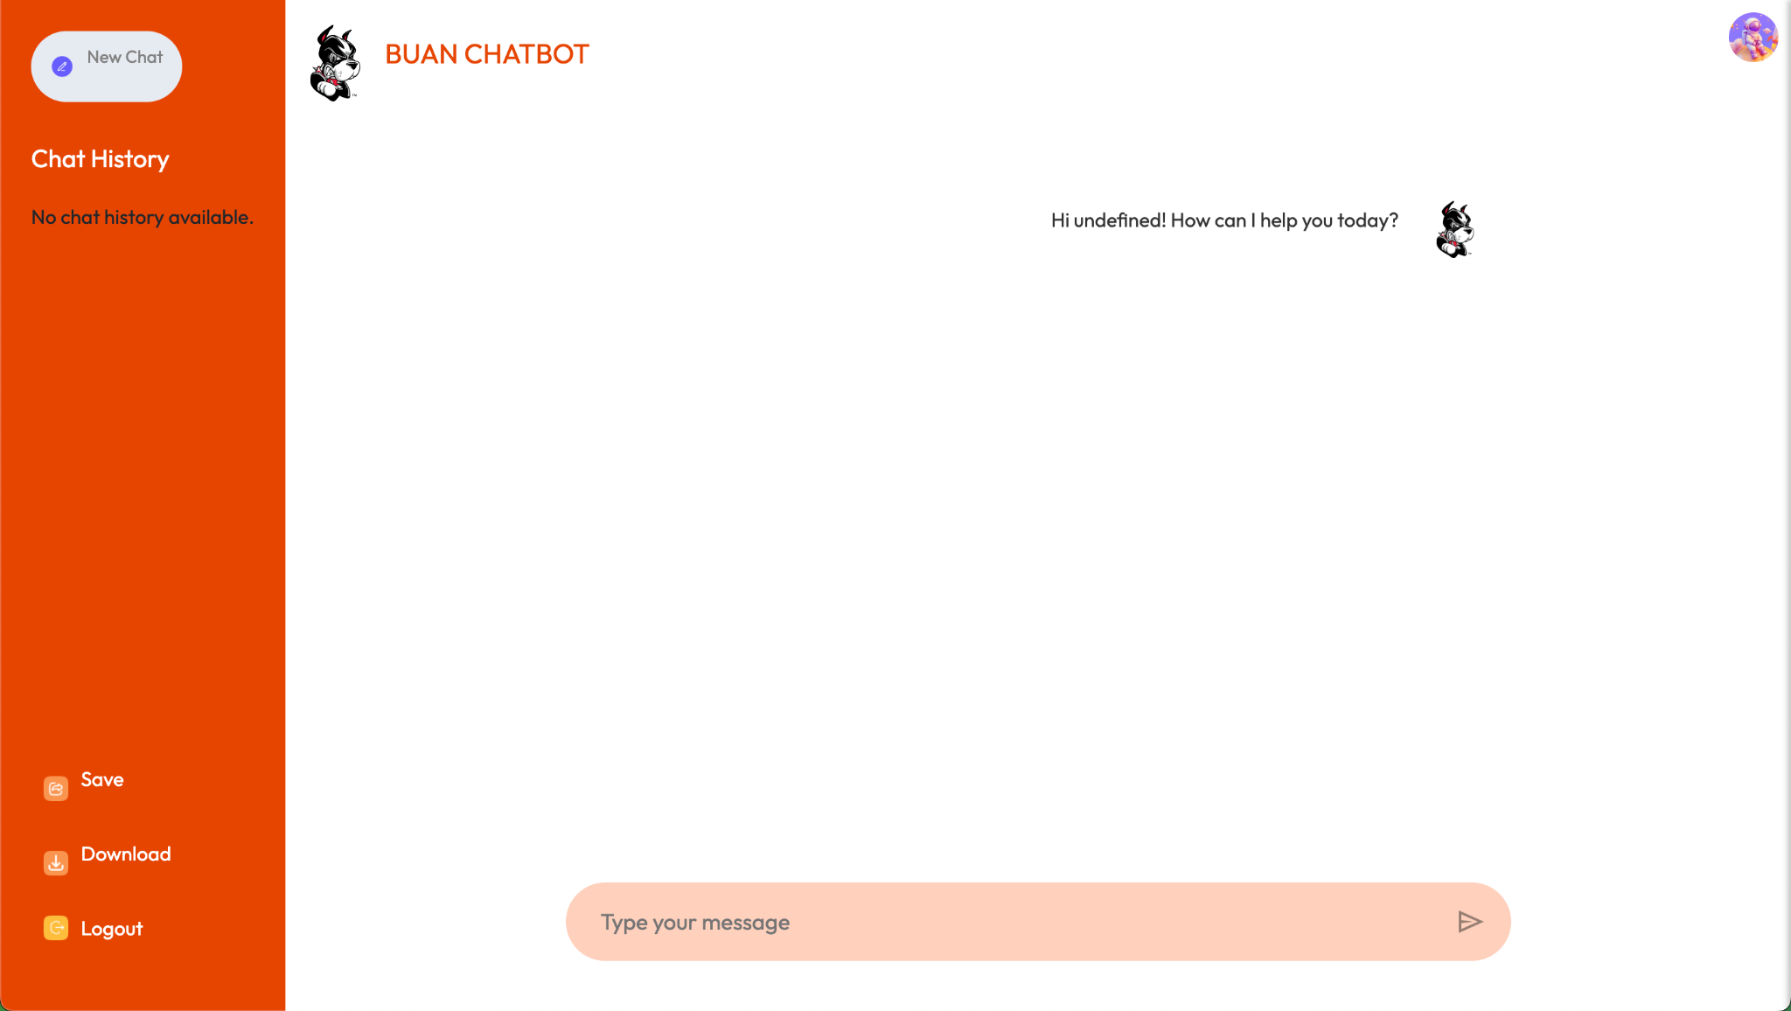
Mockup Design
Notes:
To update

Slide 13
Team Github and UI Mockups
https://github.com/BUMETCS673/seprojects-cs673olf24team1
https://www.figma.com/design/gjNG1bADwnFxgDqclMwQVQ/Chat-AI-Bot---673ONE---final-mockup?node-id=0-1

Slide 14
FrontEnd Functionalities
User logging in and signing up using JWT Token Authentication for security authentication
Easy to use GUI to interact with the BUAN chatbot
Ability to see past chat history conversation rendered in the GUI.
Able to download chat conversation into a pdf file format
Ability to save chat with BUAN chatbot for future reference

Slide 15
Changes from Last Iteration - Frontend
Added the `Download chat` implementation
Added Requirement checks for the Signup and login page to ensure correct data input.
Added success/error messages
Code cleaning, linting, reformatting, and annotation for easy handover process for future incoming developers.

Slide 16
Security Design
User Authentication: JWT authentication integration for secure login.
Sensitive Data Handling: Minimization and encryption of PII, chat logs retention.
Session Management: Automatic logout after inactivity.
State Isolation: Data hooks allow for encapsulating stateful logic
Limited exposure: expose only endpoints and functionalities, minimize the amount of code being exposed

Slide 17
Design Patterns
Factory Method Pattern
Purpose: Creates service instances based on user requests (e.g., Course Tree, Course Recommendations).
Implementation: In the future, we would like to have the Course Tree built for every student based on their current student profile, so that when they run the recommended_courses function from the Chatbot, the LLM can quickly retrieves the different options based on randomly selecting the branch and taking top x based on the courseToTake.
Observer Pattern
Purpose: Ensures real-time updates across chatbot components.
Implementation: ChatSession notifies observers (e.g., ChatWindow, ChatHistoryLogger) of changes.

Slide 18
Database Design
Users Table
user_id: Primary key, uniquely identifying each user.
auth_id: Unique identifier for authentication.
email: User email for authentication.
password_hash: Hashed password for security.
f_name: First name of user.
l_name: Last name of user.
program_code: Academic program code.
course_taken: JSONB list of completed courses.
path_interest: User's academic/career interests.
course_to_take: Next planned course.

Slide 19
Database Design
Sessions Table
session_id: Primary key, uniquely identifying each session.
user_id: Foreign key linking to Users table.
created_at: Timestamp for session start (default: current timestamp).
end_chattime: Timestamp for when a session ends.
conversation: JSONB field for chat history.

Slide 20
Postgres Database
Allowing JSONB storing for easy usage by the Springboot Backend.
Having stored procedure to cache frequently used query to increase insertion and retrieval performance.

Slide 21
Business Logic and Key Algorithms
Program and Course Information Retrieval: Query programs and courses for detailed information.
Custom-made Course Selection Assistance: Recommend courses based on user’s academic interests and history.
Personalized Chat History: Cache and retrieve past interactions to maintain context.
Complex Query Handling: Address multifaceted queries with custom logic.

Slide 22
Chatbot Model
ChatGPT 4o mini via Langchain API: Powers course recommendations and information lookup.
Functionality:
Course Recommendations: Analyzes student data to suggest upcoming semester courses.
Course & Program Information Lookup: Provides details about specific courses on request.
Other Queries on Student Life and BU MET CS department: Provides responses regarding student life, work-academic balance, and other questions relevant to the needs of students within the BU MET CS department.

Slide 23
Chatbot Model (continued)
User Interaction Flow
User logs in with username.
Inputs profile parameters (program, career path interests, courses taken, number of course taken for the next semester).
Receives personalized course recommendations.
Can query further course details.
Chat history is cached for future reference.
Ability to request alternate personalize course recommendations at command if user is not satisfied with previous recommendations
.

Slide 24
Python AI Service Functionalities
Using NLP to make conversation between chatbot to user smoother with a better ux experience.
Ability to build course recommendation for the next semester based on student history and preference.
Ability to ask chatbot about courses and programs from the BU MET CS department
Ability to ask student and program related questions about BU, program, and living in Boston.
Ability to ask who to contact if the chatbot is unable to answer the users’ question.

Slide 25
Changes from Last Iteration - Python AI service
Fixing final smells and bugs.
Adding more Exceptions to ensure all situations are taken accounted for.
Code cleaning, linting, reformatting, and annotation for easy handover process for future incoming developers.

Slide 26
Algorithm Overview: Course Builder
Input
Programs Data: Reads from CSV to create a dictionary of program attributes (core/elective courses, prerequisites).
Courses Data: Reads from CSV to generate a dictionary of course details.
Student Profile: Contains completed courses, declared interests, and desired courses to take.

Slide 27
Algorithm Overview: Course Builder (cont…)
Core Functions
CourseTree Class: Manages course recommendations via a tree structure.
add_branch: Adds course sequences to the tree while avoiding completed or skipped courses.
build_mssd_tree: Constructs a course tree based on student interests and completed courses.
recommend_courses: Traverses the tree to recommend courses for the next semester.

Slide 28
Algorithm Overview: Course Builder (cont…)
Algorithm Operation
Tree Construction: Builds a course tree dynamically based on the student's path of interest.
Recommendation Process: Identifies courses not yet taken and recommends them in the correct sequence.
Time Complexity
Tree Construction & Recommendation: Approximately O(n), where n is the total number of courses.

Slide 29
Algorithm Overview: Course Builder (cont…)
Outputs
Recommended course list based on the student’s profile.

Slide 30
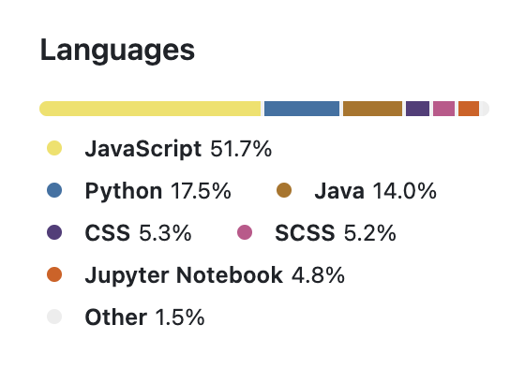
SB Backend Functionality
Efficient integration between the many services and APIs.
Having a middleware to parse and link the different variable names between the different services.

Slide 31
Changes from Last Iteration - SB backend
Integrated application with AWS EC2 Instance
Added more unit testing ensure robust services and APIs
Code cleaning, linting, reformatting, and annotation for easy handover process for future incoming developers.

Slide 32
CI/CD Integration Updates
We have a 3-tiers workspace(Develop, Stage, Production).
Linting and Formatting Requirements
Deployed AWS EC2 instance
Backup local Docker container
AWS LINKS
AI API: http://54.159.232.88:9080/api/v1/chatbot
UI: http://54.159.232.88:3000/

Slide 33
Testing and Deployment
Unit Testing: React, Spring Boot, Python AI modules tested individually.
Integration Testing: Ensures seamless communication between the frontend, backend, and AI services.
Regression Testing: Full application tested to ensure all features work as intended.
Automated Testing: Selenium for UI testing, PyTest for backend.
Deployment: AWS EC2 Instance for production deployment

Slide 34
QA/Testing Updates
Using BDD Framework with Selenium and Cucumber for UI Testing
Using Rest Assured for api testing
Testing for all feature functionalities for the product
Functional testing scenarios for AI service running at 9080
Functional testing scenarios for Spring Boot API running at 8080
Functional testing scenarios for UI running at 3000
UI and API testing framework set up and added functionalities now.

Slide 35
Tooling
JWT Authentication: We implemented JWT (JSON Web Tokens) for secure user authentication. This method allows for stateless authentication, improving the user experience by enabling users to remain logged in across sessions without needing to constantly re-enter their credentials.
Fetch API: The Fetch API is employed for making network requests to the server. It allows our application to request and retrieve data from the backend efficiently, handling both requests for course recommendations and information lookups.
Flask API: Our backend is built using Flask, a lightweight web framework for Python. The Flask API serves as the intermediary between the chatbot and the database, managing requests for course data and user authentication.
FastAPI: We also utilize FastAPI, a modern web framework for building APIs with Python. FastAPI is known for its high performance, built-in data validation, and automatic generation of OpenAPI documentation. It enables asynchronous programming, making our API calls faster and more efficient, especially under load.
Cucumber Testing: We use Cucumber for behavior-driven development (BDD) testing. This tool allows us to write acceptance tests in plain language, facilitating communication between developers, testers, and non-technical stakeholders. It helps ensure our application meets business requirements and performs as expected.
Automation: Automation tools and scripts are integrated into our workflow to streamline various processes, including testing, deployment, and continuous integration. Automation reduces human error and increases efficiency, allowing developers to focus on building features.
JIRA: We utilize JIRA for project management and tracking tasks. It helps organize work into manageable segments, assign responsibilities, and monitor progress, ensuring that all team members are aligned on goals and deadlines.
GitHub: GitHub serves as our version control system, where all project code is stored, tracked, and managed. It facilitates collaboration among team members through features like branching, pull requests, and issue tracking.
Axios: Axios is a promise-based HTTP client used in our frontend for making requests to the Flask and FastAPI backends. It simplifies the process of handling asynchronous requests and allows for easy integration of error handling and response data management.
Langchain: Langchain is the framework we use to connect our chatbot with the ChatGPT model. It provides the necessary tools and abstractions to manage interactions, enabling us to build robust conversational agents.
Docker: Docker is used to containerize our application, ensuring that it runs consistently across different environments. This makes deployment easier and enhances scalability, allowing our application to handle varying loads.
AWS: We deploy our application on Amazon Web Services (AWS), leveraging its robust infrastructure for hosting, storage, and computing. AWS allows us to scale our resources dynamically based on demand and provides various services that enhance our application's capabilities.

Slide 36
Management Style
Due to our number of experienced members, we had a mentor-mentee method of collaboration
Focusing on respect, communication, and initiative between members, we manage to go through the 6 weeks project with high calibre to deliverables.
Initially, we divided based on nuclear teams: Python AI service team, Frontend team, SB team, QA team. But quickly realized in iteration 2 that it didn’t work, and shifted to a mentor-mentee system.
Having our random day working sessions in Discord where team members can jump in and work together on anything.
Having someone to audit/review work before submission or pushing to the next stage of production.

Slide 37
Risk Management
Risk: Lack of motivation, procrastination, inconsistent work output, or team members dropping out could hinder progress and lead to missed deadlines.
Risk: Unclear requirements, frequent changes, or uncontrolled expansion of project scope could lead to delays and inefficiencies.
Risk: Integration challenges, failed CI pipeline runs, or inconsistent development and production environments could cause delays and regression.
Risk: Insufficient testing could lead to undetected bugs or issues in production, reducing system reliability.
Risk: Team members may face challenges using new technologies like Docker, FastAPI, PostgreSQL, GPT-4, or Spring Boot, leading to delays in task completion.
Risk: Miscommunication, avoidance of issues, or poor collaboration can lead to duplicate work, missed deadlines, or incomplete tasks.
Risk: Some team members may take on more work than others, leading to burnout or reduced quality of work output.
Risk: Single access to the OpenAI API key owned by Poom could create a bottleneck, limiting testing opportunities for AI-related services.
Risk: Unexpected emergencies or busy work schedules might limit team members' ability to meet project deadlines.

Slide 38
Iteration 3
Iteration Summary
Iteration 0:
Planning architecture design
Setting up requirements
Defining application features
Establishing team culture and work routine
Iteration 1:
Adding Chatbot implementation
Adding custom course recommendation algorithm
Setting up SpringBoot Backend
Setting up Frontend React and finishing the Chatpage UI components
Iteration 2:
Finishing Frontend main functionalities, saving chat into the database, signup/login functionality using JWT Auth
Adding promptlib.json as a RAG and increasing the scope of queries to accept larger query possibilities
Setting up AWS EC2 Instance for iteration 3
Setting up QA/Testing BDD framework and unit testing
Fully end-to-end integration between all services
Adding more security layer to the product
Adding the `download chat` functionality
Adding more testing and QA
Adding more linting/formatting measures
Cleaning and Annotating the code to allow easy collaboration among development team members.
Adding Exceptions for taking account all possible situations that might occur, and bugs.
Notes:
Iteration 0 Link: https://youtu.be/g12YR7aotc0?feature=shared
Iteration 1 Link: https://cdnapisec.kaltura.com/html5/html5lib/v2.101/mwEmbedFrame.php/p/2159741/uiconf_id/45028821/entry_id/1_2eq2v3jm?wid=_2159741&iframeembed=true&playerId=kaltura_player&entry_id=1_2eq2v3jm&flashvars[streamerType]=auto&amp;flashvars[localizationCode]=en&amp;flashvars[sideBarContainer.plugin]=true&amp;flashvars[sideBarContainer.position]=left&amp;flashvars[sideBarContainer.clickToClose]=true&amp;flashvars[chapters.plugin]=true&amp;flashvars[chapters.layout]=vertical&amp;flashvars[chapters.thumbnailRotator]=false&amp;flashvars[streamSelector.plugin]=true&amp;flashvars[EmbedPlayer.SpinnerTarget]=videoHolder&amp;flashvars[dualScreen.plugin]=true&amp;flashvars[hotspots.plugin]=1&amp;flashvars[Kaltura.addCrossoriginToIframe]=true&amp;&wid=1_3j73gq8j
Iteration 2 Link: https://www.loom.com/share/ff29ccbb2a354c49a3b8b4c4194337ec?sid=9892123a-aee8-4884-8156-ec409955fde2
Iteration 3 Link: [coming soon]

Slide 39
Future Work Proposal - if it can grow outside CS673
Integrating with the BU MET CS Student Registration MS
Compiling our csv documents and json prompt lib into MongoDB to allow scalability for easy additions to programs, courses, and prompt insertion.
Fixing bugs that we couldn’t get: JsPDF, Random files generated by the Docker build.
Removing smells and making code more dynamic, like the coursebuilder algorithm
Moving from JWT Token Authentication to Okta Authentication, adding Captcha features to the submit buttons in the Login/Submit Page, having ability to change some profile information. Allowing sharing through email or social media.
Allowing a user to have more than one sessions running at the same time.
Connecting user to key contact person. Eg. For question on Health, connect to BU SHS by automated email or in-person chat; Course Advising issue, connect to the BU MET CS Academic Advisor through email or in-person chat.
Moving from React Context API to Redux API so that we can use a global state for our application

Slide 40
Presentation Video Links
Iteration 0 Link: https://youtu.be/g12YR7aotc0?feature=shared
Iteration 1 Link: https://cdnapisec.kaltura.com/html5/html5lib/v2.101/mwEmbedFrame.php/p/2159741/uiconf_id/45028821/entry_id/1_2eq2v3jm?wid=_2159741&iframeembed=true&playerId=kaltura_player&entry_id=1_2eq2v3jm&flashvars[streamerType]=auto&amp;flashvars[localizationCode]=en&amp;flashvars[sideBarContainer.plugin]=true&amp;flashvars[sideBarContainer.position]=left&amp;flashvars[sideBarContainer.clickToClose]=true&amp;flashvars[chapters.plugin]=true&amp;flashvars[chapters.layout]=vertical&amp;flashvars[chapters.thumbnailRotator]=false&amp;flashvars[streamSelector.plugin]=true&amp;flashvars[EmbedPlayer.SpinnerTarget]=videoHolder&amp;flashvars[dualScreen.plugin]=true&amp;flashvars[hotspots.plugin]=1&amp;flashvars[Kaltura.addCrossoriginToIframe]=true&amp;&wid=1_3j73gq8j
Iteration 2 Link: https://www.loom.com/share/0f89d6608282436ebb194db4e7251023
Iteration 3 Link: https://www.loom.com/share/1e8b338f0da64e969b6d92ad1fbdf287

Slide 41
Documents Links
SDD: https://docs.google.com/document/d/1ch7LNgubW-kMXYYZ7vxoAuGzv9BuCsDV/edit?usp=drive_link&ouid=103114635327311797188&rtpof=true&sd=true
STD: https://docs.google.com/document/d/1WmKCcI4Q6M4MueD_hz1-Qc8Monilb4rD/edit?usp=drive_link&ouid=103114635327311797188&rtpof=true&sd=true
SPPP: https://docs.google.com/document/d/1zvKDvFPU8075OQi3H5Sab6zUKd-R-9RC/edit?usp=drive_link&ouid=103114635327311797188&rtpof=true&sd=true
SPPP Risk: https://docs.google.com/spreadsheets/d/1PKZ_67GZ0AT9tjyAr6T7fItjEC_KtlzV/edit?usp=drive_link&ouid=103114635327311797188&rtpof=true&sd=true
Progress Report: https://docs.google.com/spreadsheets/d/11tNnA4n-sdLOFztepMadfqetSaNK8Jmd/edit?usp=drive_link&ouid=103114635327311797188&rtpof=true&sd=true
Ppt slides: https://docs.google.com/presentation/d/1d26JZwDBMzP2OF2K364n-KFrHzGN8_-o/edit?usp=drive_link&ouid=103114635327311797188&rtpof=true&sd=true
JIRA: https://seprojects-cs673olf24team1.atlassian.net/jira/software/projects/SCRUM/boards/1/backlog

